Slide 1
Managing HIV Tester Certification Data

Slide 2
Learning Objectives
At the end of the session, you will be able to:
  Understand what constitute the certification data
  Describe what are the key elements of the certification data management process
  Understand the purpose of the certification data management tool
  Describe the different components of the certification data management tool

Slide 3
Type of Certification Data
Provider information
  Name
  Geographic location
  Affiliation
  Contact
  Contact of person in charge
Training information
  Type of training
  Training organization
  Trainer(s)
  Training certificate
Examination
  Written exam
  Practical exam
  Examiner/Proctor
  Number of attempts
Certification
  Type of certification
  Certification Issuer
  Date of issuance
  Recertification reminder email
  Recertification information

Slide 4
Key Data Management Areas
Data collection/capture
  Written and practical examination documentation
  Registration sheet
  Database (Excel or Web-based dashboard)
Data Quality
  Review/Quality check
  Double entries
  Validation
Data Access
  National: MOH/Certification Body
  Regional/District/Provincial: Registrar, Data clerk/manager
  Mid-level: Evaluator, Proctor, data clerk
  Site: Tester
Data Security
  Transport
  Electronic transfer
  Storage / Archiving
    Physical
    Electronic

Slide 5
Managing the Certification Data
1. Collect
2. Review
Registration sheet, written examination sheet and practical examination result forms
Direct observation checklists
Written examination questions + answer key
3. Transport
All paper tools containing tester information examination data
4. Check
Written examination questions + answer key
All paper tools containing tester information examination data
5. Transfer
All paper tools containing tester information examination data
Completeness and accuracy
At regional level: Transfer Into database all paper based data collected
To Council: Transfer all electronic data captured every month

Slide 6
Excel Certification Data Management Tool
Designed to manage certification data for documentation, monitoring and evaluation purpose
User
  Regional: Evaluator, data clerk
  National (MOH, Certification Body): Registrar, data clerk
Contains four worksheets
  Instructions
  Tester Demographic information
  Tester Training information
  Tester Certification information

Slide 7
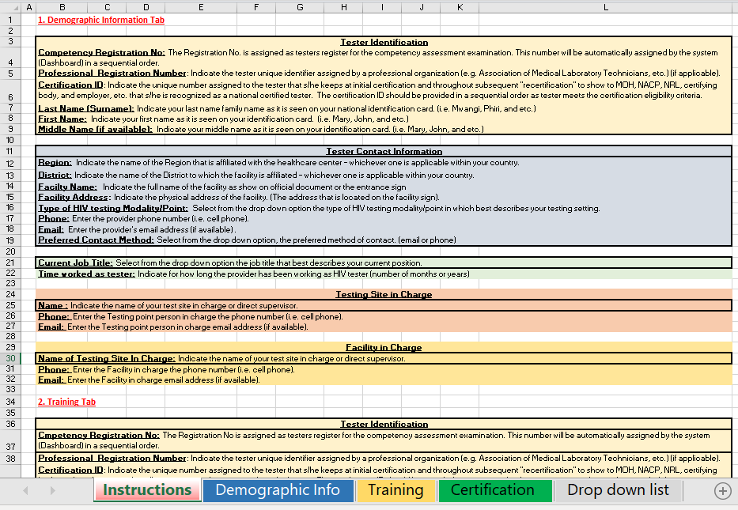
Tab 1. Instructions

Slide 8

Tab 2. Tester Demographic Information

Slide 9
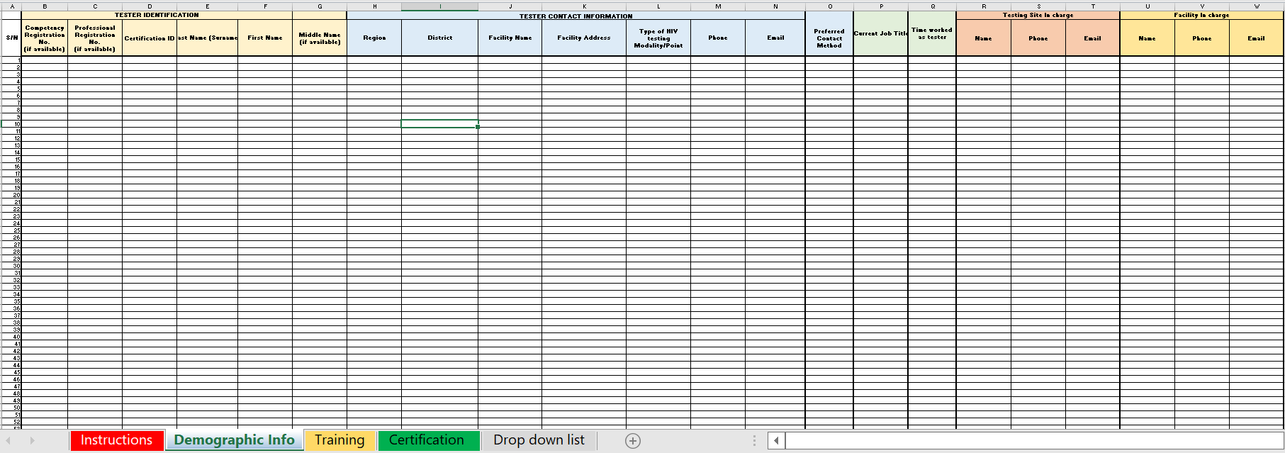
Tab 2. Tester Demographic Information

Slide 10
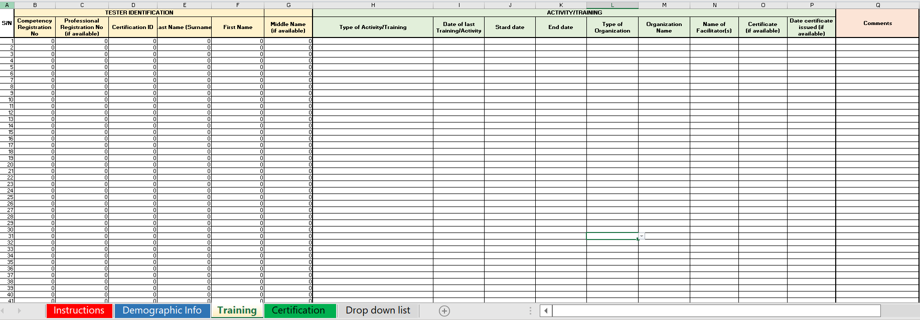
Tab 3. Tester Training Information
Initial training (nationally approved RT training)
Initial training (on the job training by peer)
In-service training (on job by supervisor)
In-service training (nationally approved)
In-service training (distance learning, i.e., ECHO)
Mentoring (on job by supervisor)
Mentoring (distance learning, i.e., ECHO)
Refresher training (nationally approved RT training)
Refresher training (topic specific training)
Regional workshop
FBO
Government
NGO
Private

Slide 11
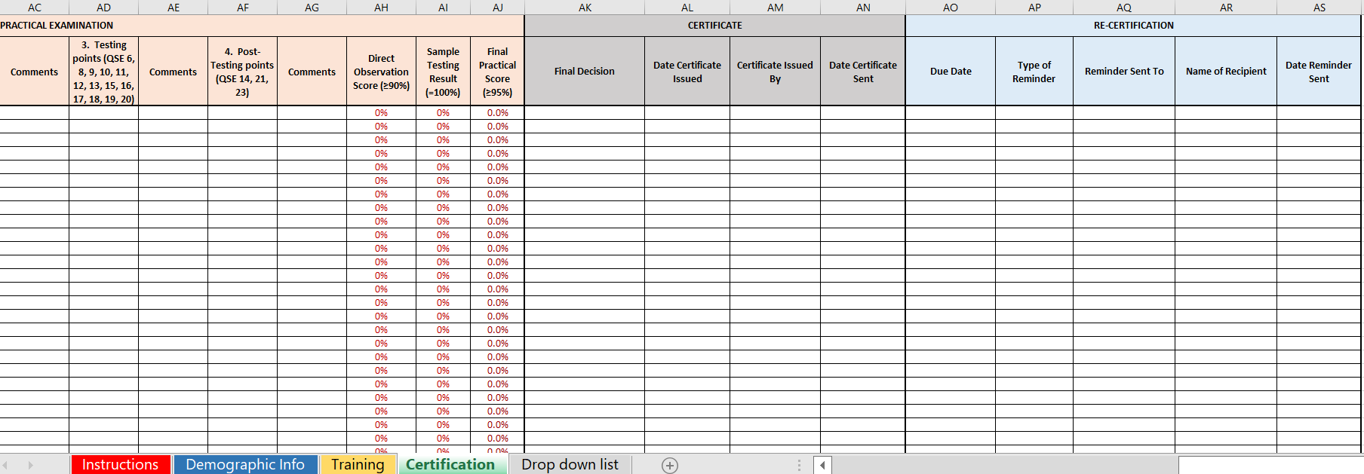
Tab 4. Tester Competency Assessment and Certification Information
Certified
Failed
Pending
Email
Phone
District Lab Technologist
Facility in charge

Slide 12
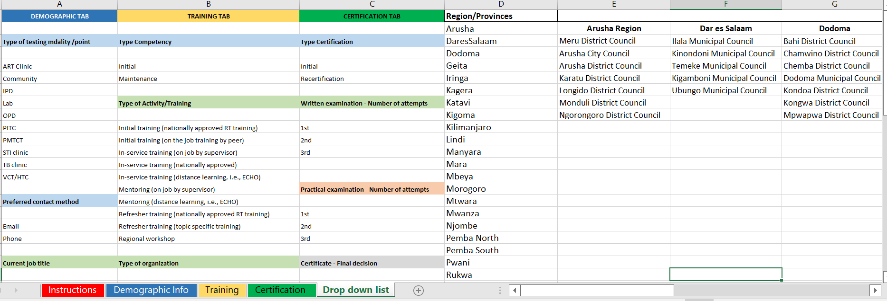
Tab 5. Drop Down List

Slide 13
Summary
What the different types of certification data?
What are the key elements of the certification data management process?
What is the purpose of the certification data management tool?
What are the different components of the certification data management tool?

